Slide 1
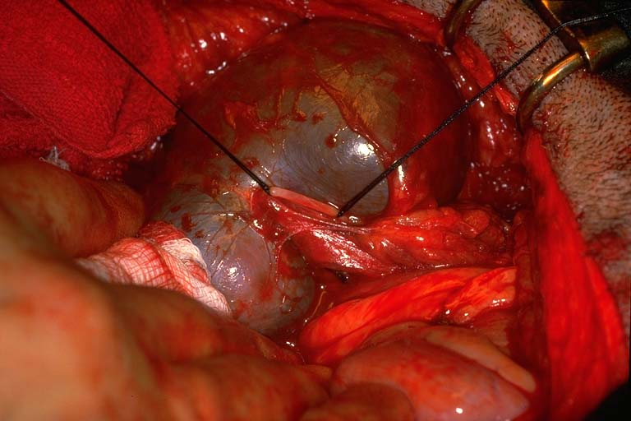
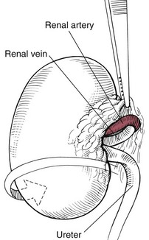
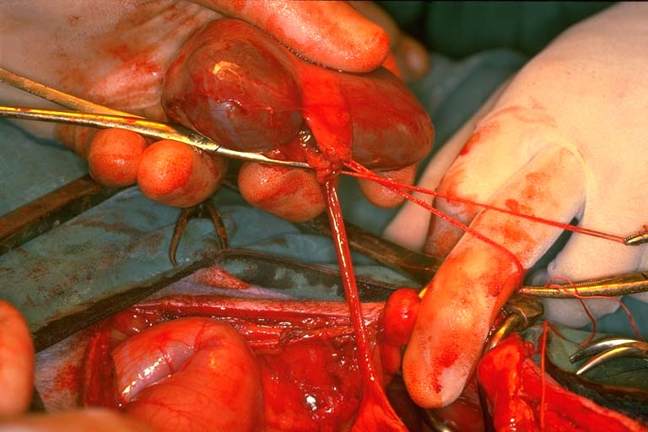
Nephrectomy
.

Slide 2
urolithiasis

Slide 3
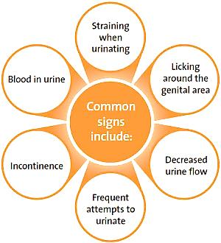
Common clinical signs of Urolithiasis

Slide 4
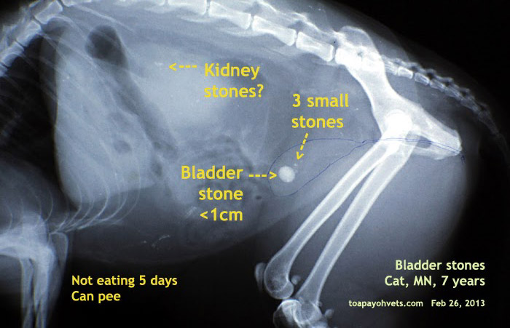
urolithiasis

Slide 5
ureter
Ureterotomy
Ectopic ureter
Is a congenital anomaly in which one or both ureter empty outside the bladder

